Slide 1
SOCIAL DISTANCE MONITORING USING MACHINE LEARNING
Presentation by Santhanakumar V

Slide 2
ABSTRACT
In this futuristic world of self-driving cars and voice assistants, computer science and machine learning play an important role in making our dream of automated living come true. This project is based on Object detection which is a direct application of object identification in the domain of Machine Learning and monitoring the social distance of people by finding the distance between people.
We’ve trained the model with a custom database and the trained model is used to test new images and videos. mAP scores have been obtained for the trained weight files. The detected people’s distance is measured by finding the Euclidean distance between the bounding boxes and a red bounding box is drawn, if the people are found to be close to each other. The final result is an ML model which can detect and monitor the social distance between people.

Slide 3
MACHINE LEARNING

Slide 4
Machine learning is a buzzword for today's technology, and it is growing very rapidly day by day. We are using machine learning in our daily life even without knowing it such as Google Maps, Google Assistant, and Alexa, machine learning is a method of data analysis that automates analytical model building.
Machine learning (ML) is a type of artificial intelligence (AI) that allows software applications to become more accurate at predicting outcomes without being explicitly programmed to do so. Machine learning algorithms use historical data as input to predict new output values.
Systems that get smarter and smarter over time without human intervention are ML. Deep Learning (DL) is a machine learning (ML) applied to large data sets. Most AI work involves ML because intelligent behavior requires considerable knowledge.

Slide 5
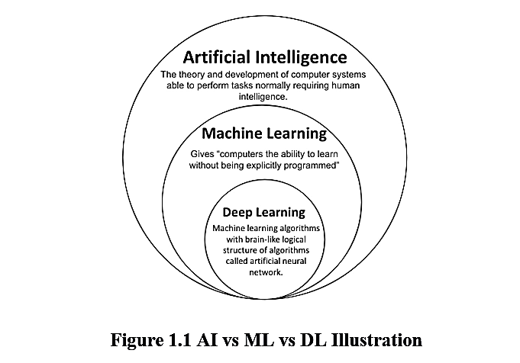

Slide 6
WORKING OF MACHINE LEARNING ALGORITHMS
Machine Learning algorithms utilize a variety of techniques to handle large amounts of complex data to make decisions. These algorithms complete the task of learning from data with specific inputs given to the machine. It’s important to understand how these algorithms and a machine learning system as a whole work, so that we can get to know how these can be used in the future.
This enables the ML algorithm to learn on its own and produce an optimal answer that will gradually increase in accuracy over time. After a desired level of accuracy is obtained, the machine learning algorithm is deployed.

Slide 7
A Decision Process: In general, machine learning algorithms are used to make a prediction or classification. Based on some input data, which can be labeled or unlabeled, your algorithm will produce an estimate of a pattern in the data.
An Error Function: An error function serves to evaluate the prediction of the model. If there are known examples, an error function can make a comparison to assess the accuracy of the model.
A Model Optimization Process: If the model can fit better to the data points in the training set, then weights are adjusted to reduce the discrepancy between the known example and the model estimate. The algorithm will repeat this evaluation and optimize the process, updating weights autonomously until a threshold of accuracy has been met.

Slide 8
TYPES OF MACHINE LEARNING METHODS
Supervised learning, Unsupervised and Reinforcement learning

Slide 9
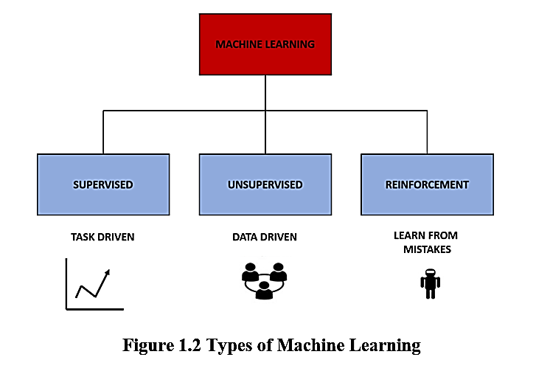

Slide 10
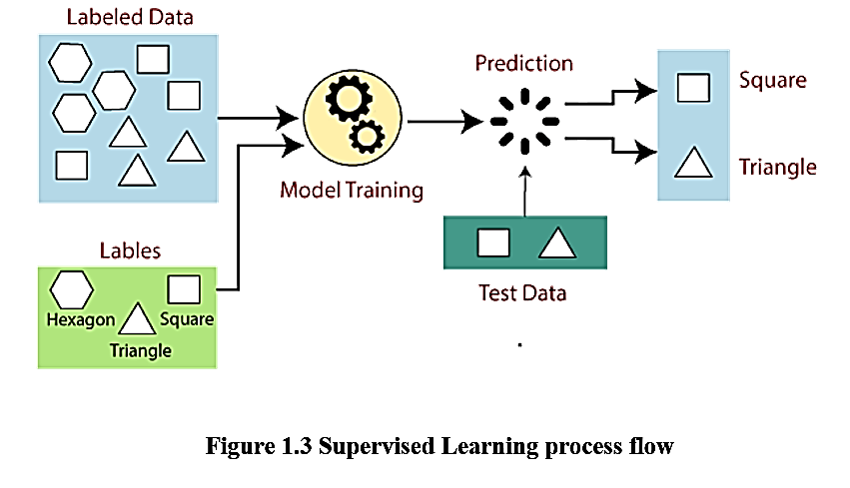

Slide 11
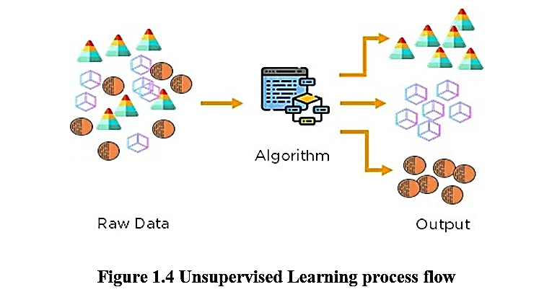

Slide 12
SOCIAL DISTANCE MONITORING USING MACHINE LEARNING

Slide 13
In this project, the darknet’s YOLO v4 object detection algorithm is used. The custom dataset is collected with multiple classes with their respective labels and class names, which will be trained and tested for accuracy scores and better evaluation. The following steps are followed for the successful completion of this project.
Dataset Collection
Annotation
Model Training
Model Testing
Performance Evaluation
Measuring the Euclidean Distance

Slide 14

MEAN ABSOLUTE ERROR
Regression metric which measures the average magnitude of errors in a group of predictions, without considering their directions. In other words, it’s a mean of absolute differences among predictions and expected results where all individual deviations have even importance.
Figure 3.3 Calculating Mean Absolute Error

Slide 15
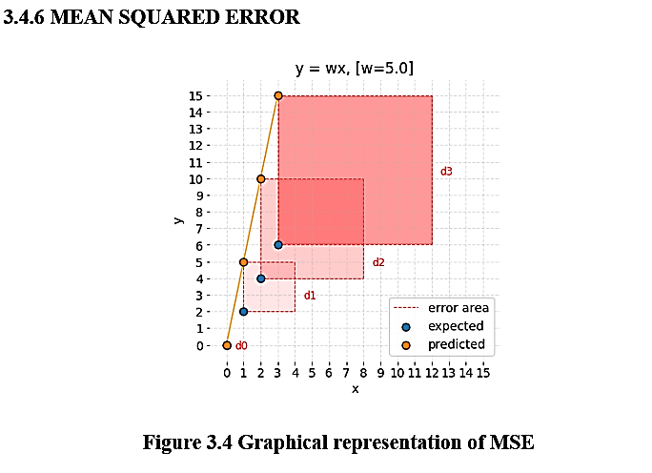

Slide 16
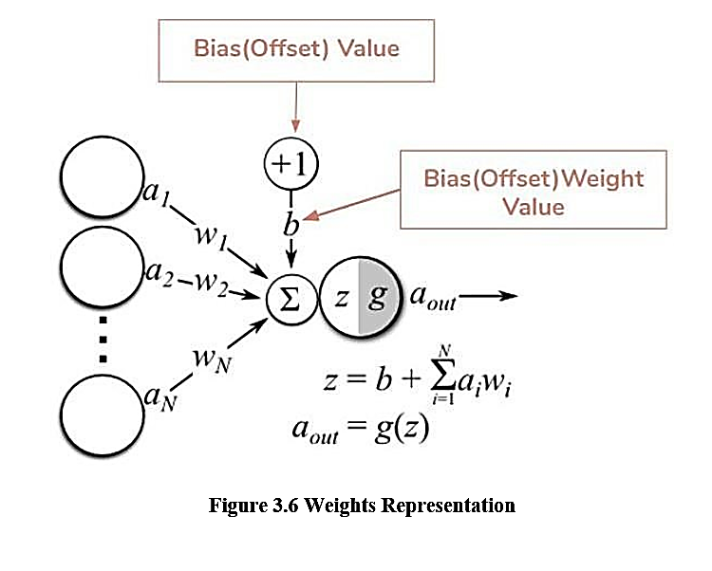

Slide 17
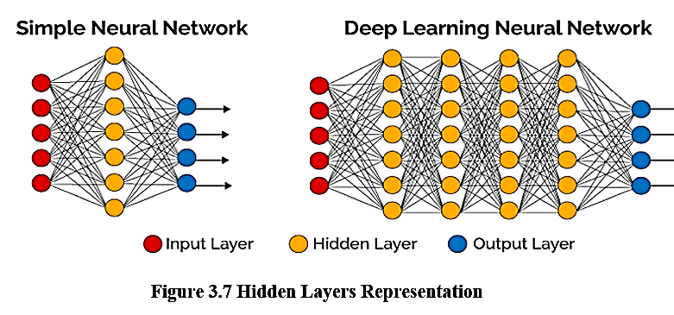

Slide 18
SOFTWARE REQUIREMENTS

Slide 19
The model training requires intense computational power, thus to meet the required demands, we need CUDA, CUDA® is a parallel computing platform and programming model developed by NVIDIA for general computing on graphical processing units (GPUs).
The easiest and most affordable way is to use Google's Collaboratory. Colab notebooks allow you to combine executable code and rich text in a single document, along with images, HTML, LaTeX, and more.
Each user gets a 12hr free continuous runtime which is enough for the model to train for around 4000 iterations. Google collab provides GPU runtime which offers more memory for higher computational power.

Slide 20
RESULT ANALYSIS

Slide 21
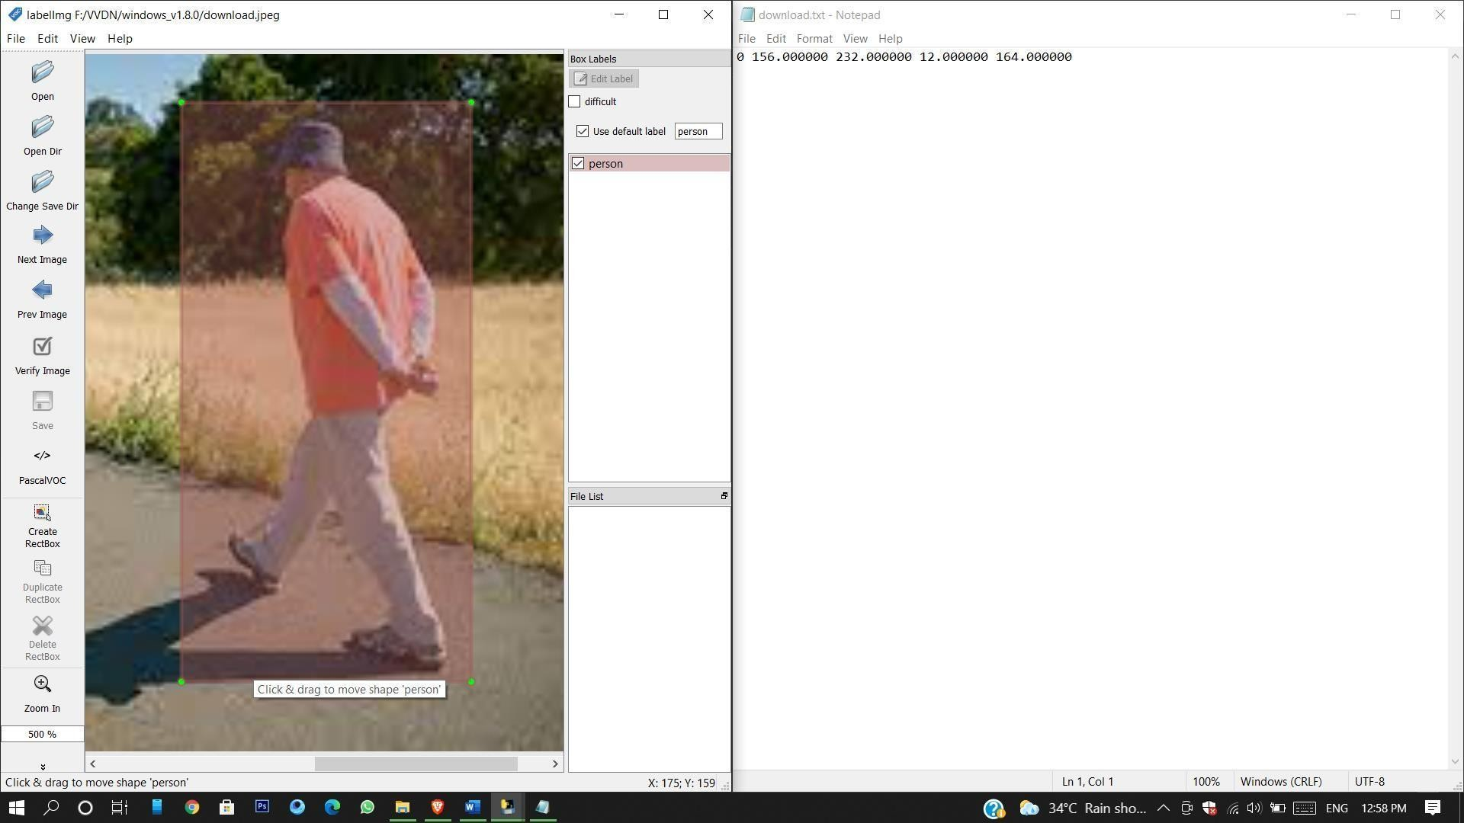
Figure 4.1 Labeled Image and its corresponding .txt file

Slide 22
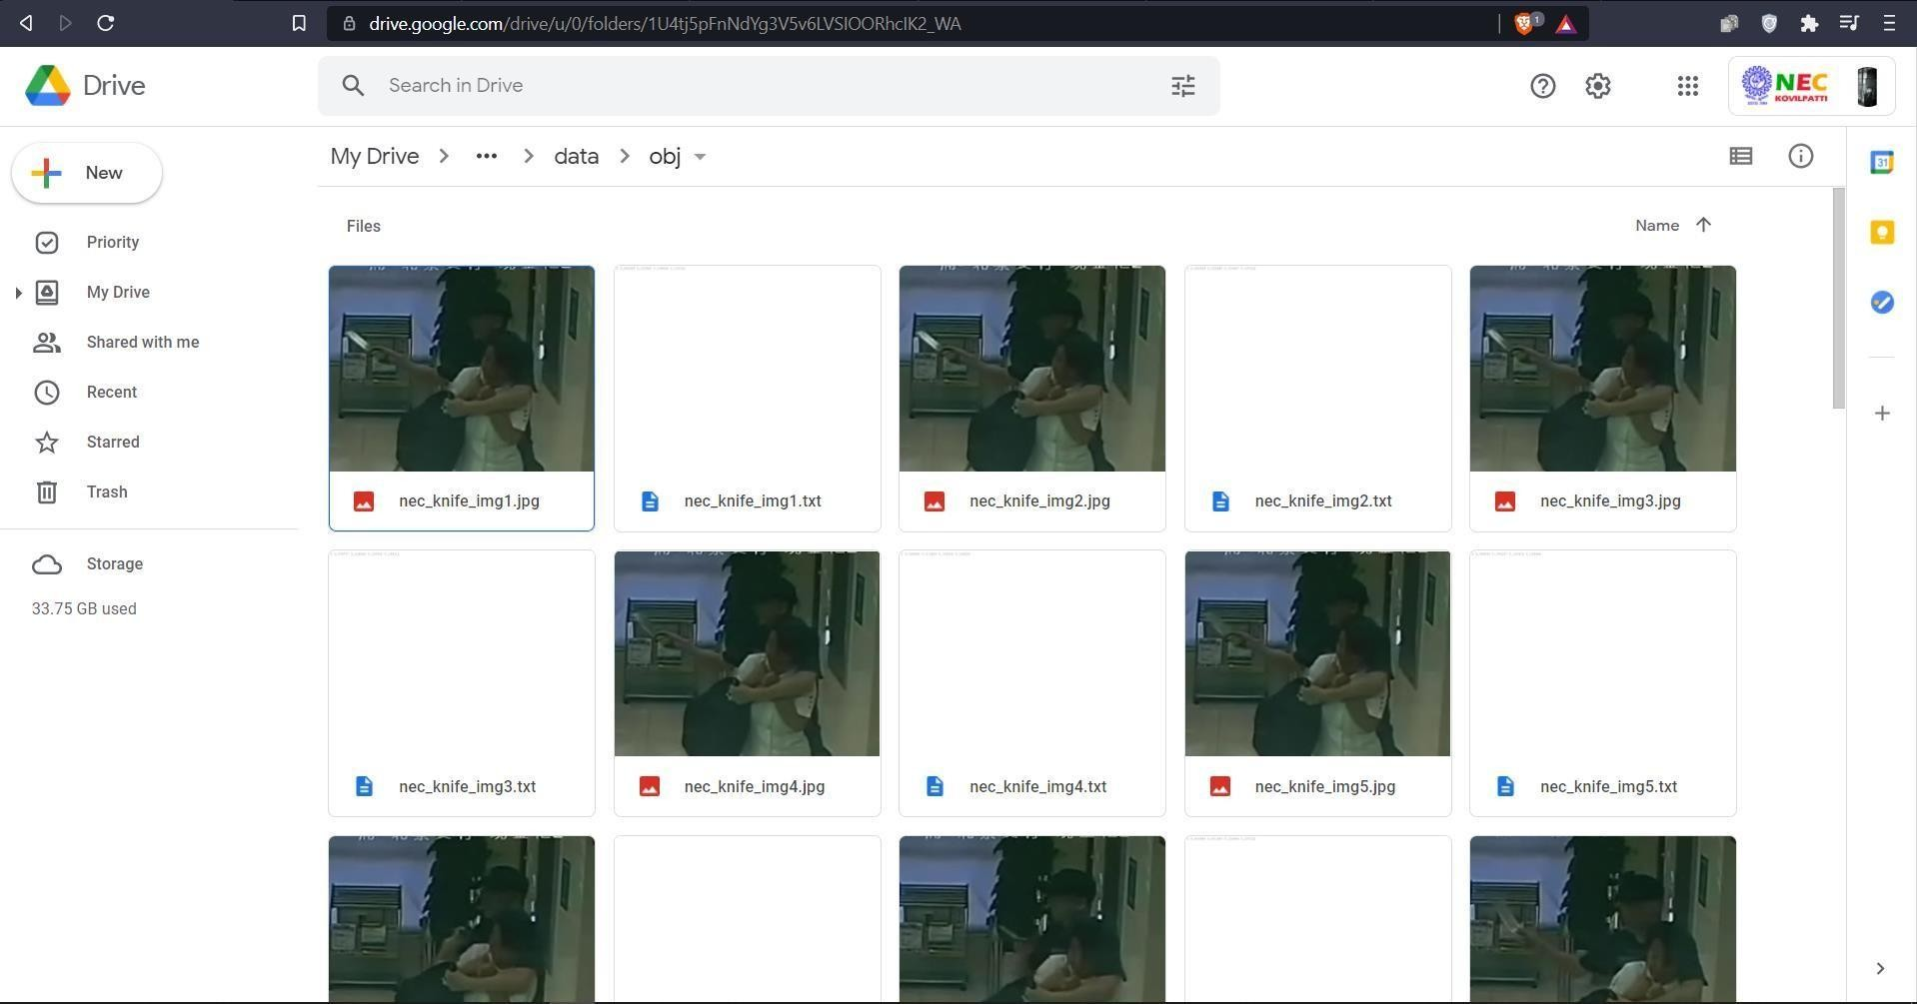
Figure 4.2 Dataset collected and uploaded to the drive

Slide 23
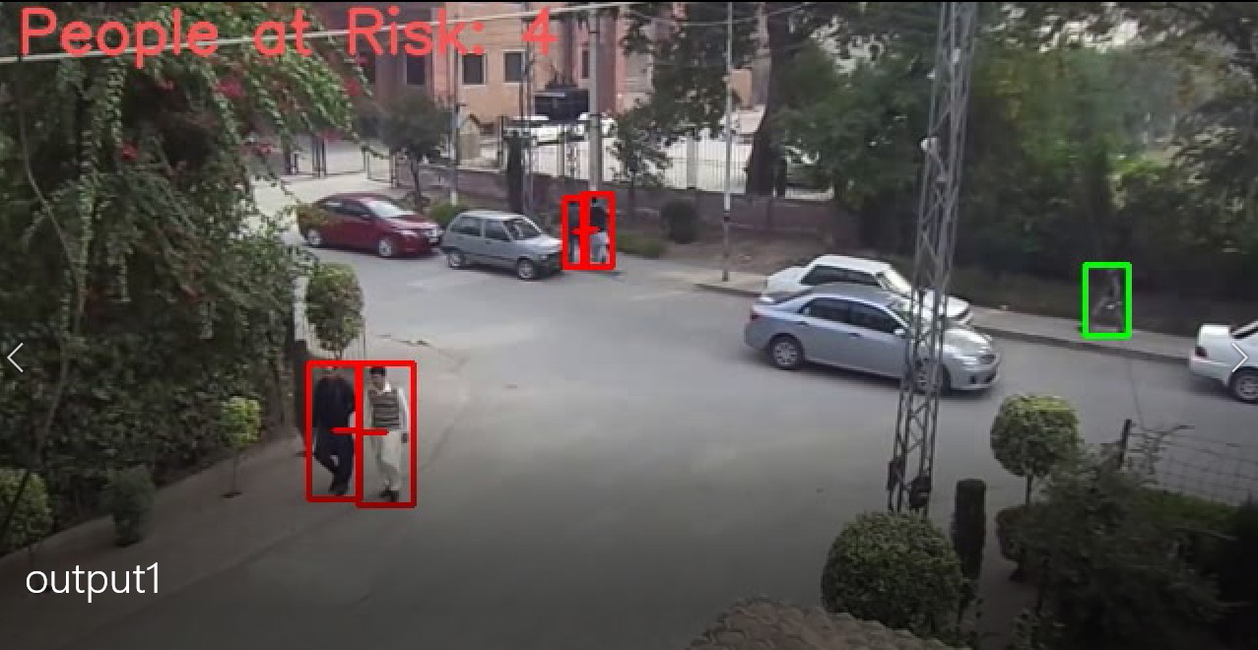
The final samples from the videos are attached as frames below:
Figure 4.6 Output Sample 1

Slide 24
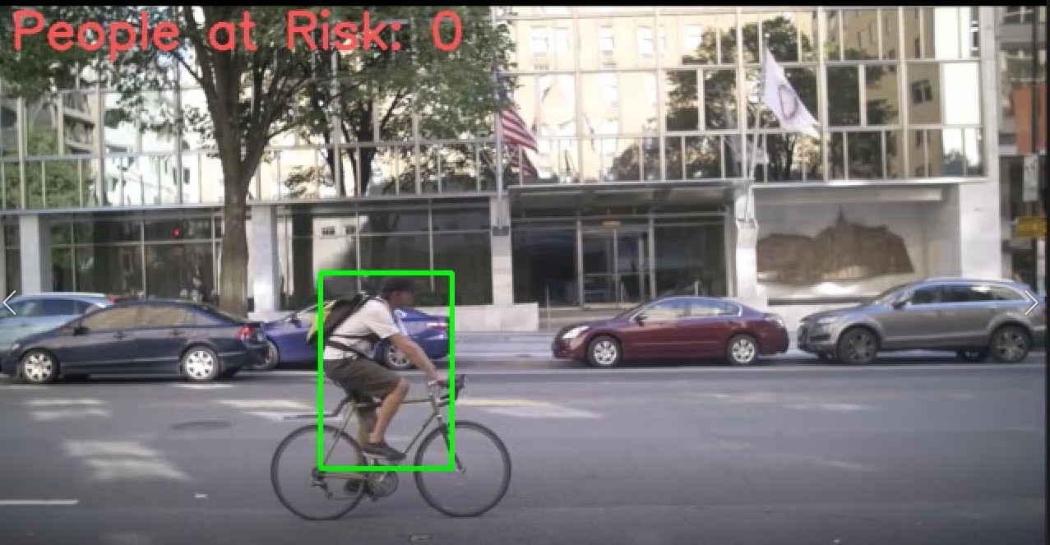
Figure 4.7 Output Sample 2

Slide 25
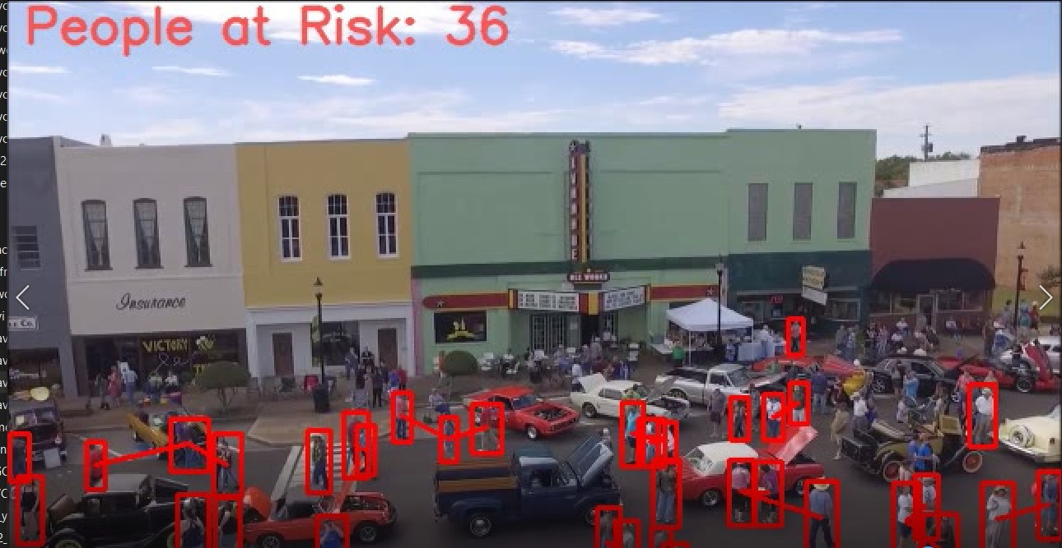
Figure 4.8 Output Sample 3

Slide 26
CONCLUSION & FUTURE WORK

Slide 27
With the current technological advancements, it’s no doubt that in the next few years there will be automated vehicle transportations and much more applications to be developed for monitoring such as the Social Distancing application.
With a much larger dataset and more iterated files can be more efficient than the current one, with much computational power we can power multiple camera feeds at the same time. Thus the outcome of this model can help people track, monitor and measure easier and save time for the advancement of our daily routine in the near future in almost all the fields.
Further, it was found that the finding the distance between the detected objects can be improved by calculating the depth of the image using computer vision. By applying differentiable warping to frames and comparing the result to adjacent ones, it provides several improvements. We can address occlusions geometrically and differentiably, directly using the depth maps as predicted during training.

Slide 28
THANK
YOU

